Slide 1
C++ Programming Design
Session #2

Slide 2
#2 Setting Out to C++
Creating a C++ program
The general format for a C++ program
The #include directive
The main() function
Using the cout object for output
Placing comments in a C++ program
How and when to use endl
Declaring and using variables
Using the cin object for input
Defining and using simple functions

Slide 3
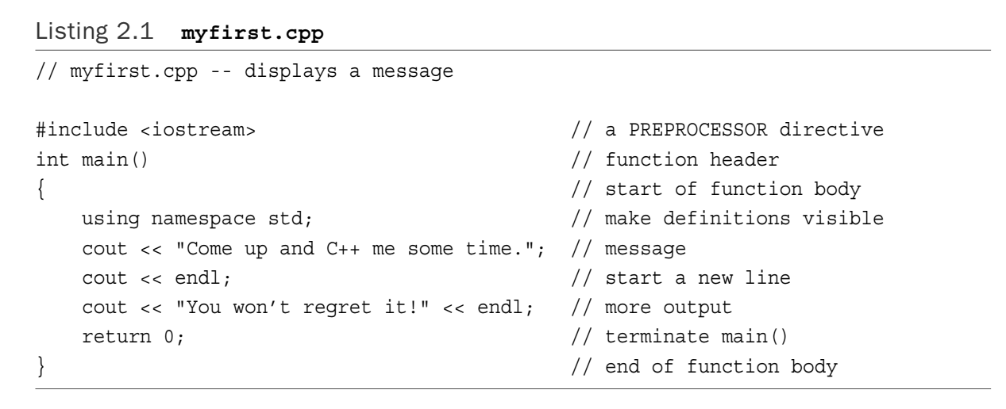
C++ Initiation

Slide 4
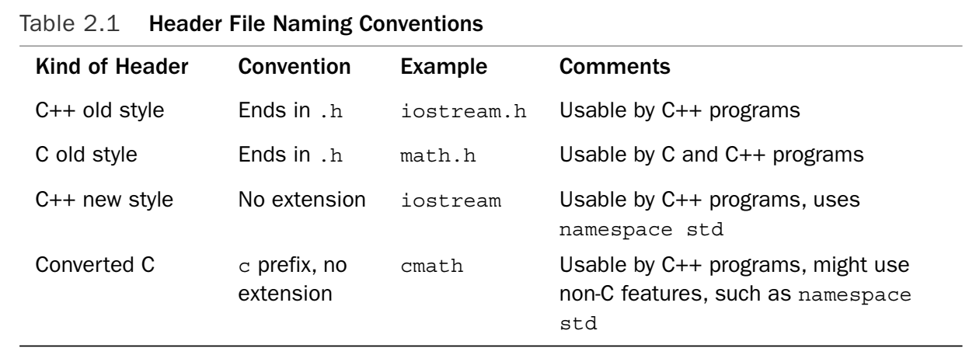
C++ Initiation: header file
#include <iostream>

Slide 5
C++ Initiation: main() header
int main()
main()
int main(void)
void main()
//C style
//C/C++
//not always succeed

Slide 6
C++ Initiation: the beginning of program
The beginning of program: main()
Exceptions:
(1)Dynamic link library (DLL)
(2)Specialized environments, such as for a controller chip in a robot
(3) _tmain()

Slide 7
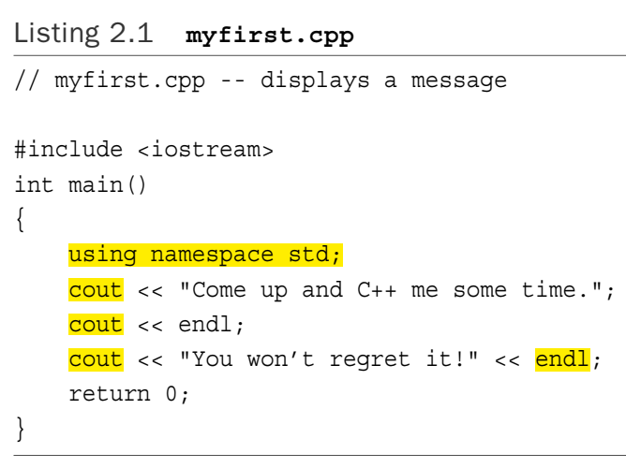
C++ Initiation: namespace
using namespace std;
cout，endl is in std
Alternatives:
(1)std::cout<<"Come up and C++ me some time.”;
(2)using std::cout;
cout<<"Come up and C++ me some time.”;//RIGHT
cout<<endl; //WRONG

Slide 8
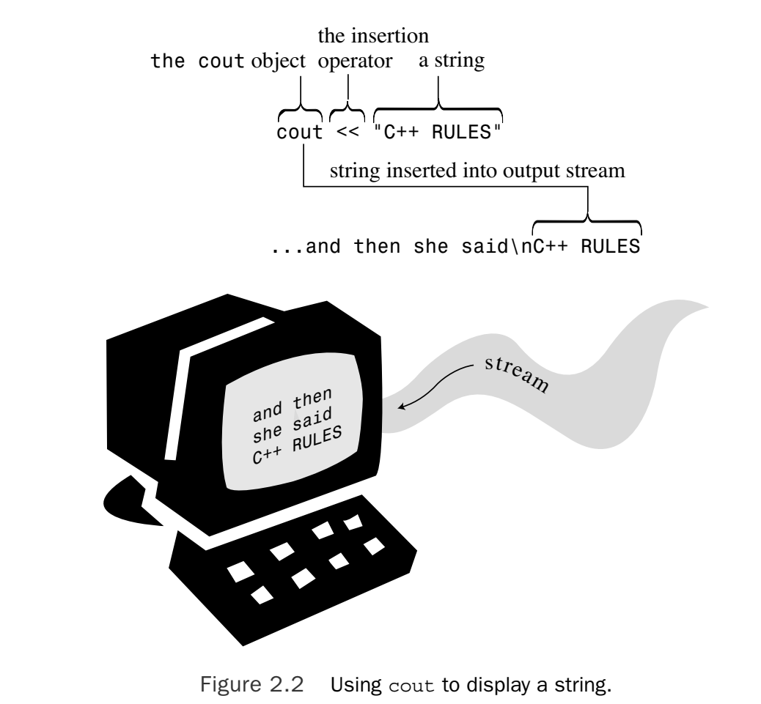
C++ Initiation: cout

Slide 9

C++ Initiation: endl
(1)Typically, use an embedded newline character (\n) when displaying quoted strings and the endl manipulator otherwise.
(2)endl guarantees the output will be flushed.

Slide 10
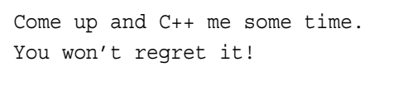
C++ Initiation
The output：

Slide 11
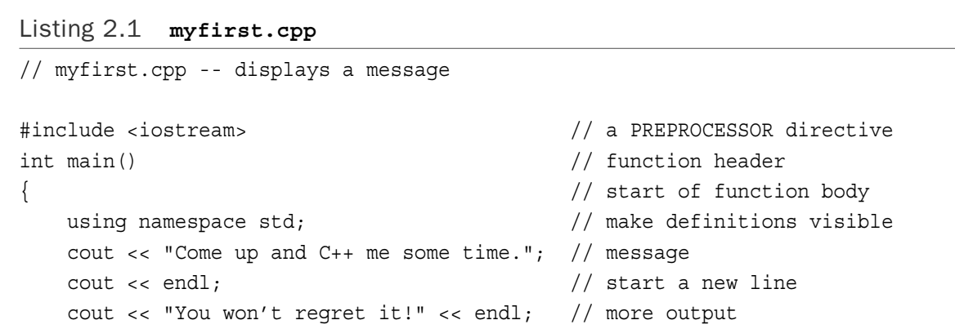
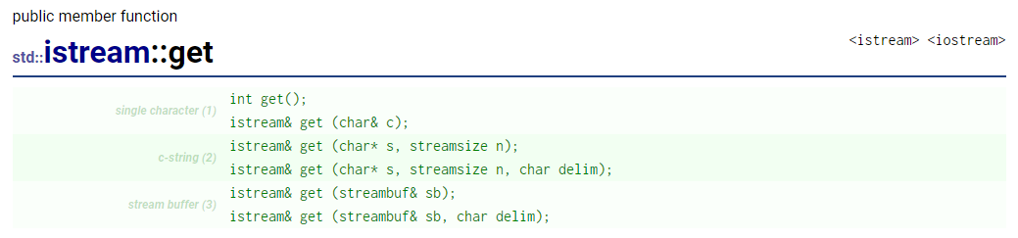
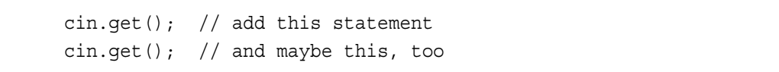
C++ Initiation: Alternative
https://cplusplus.com/reference/istream/istream/get/
Notes:
https://cplusplus.com/reference/istream/istream/get/

Slide 12
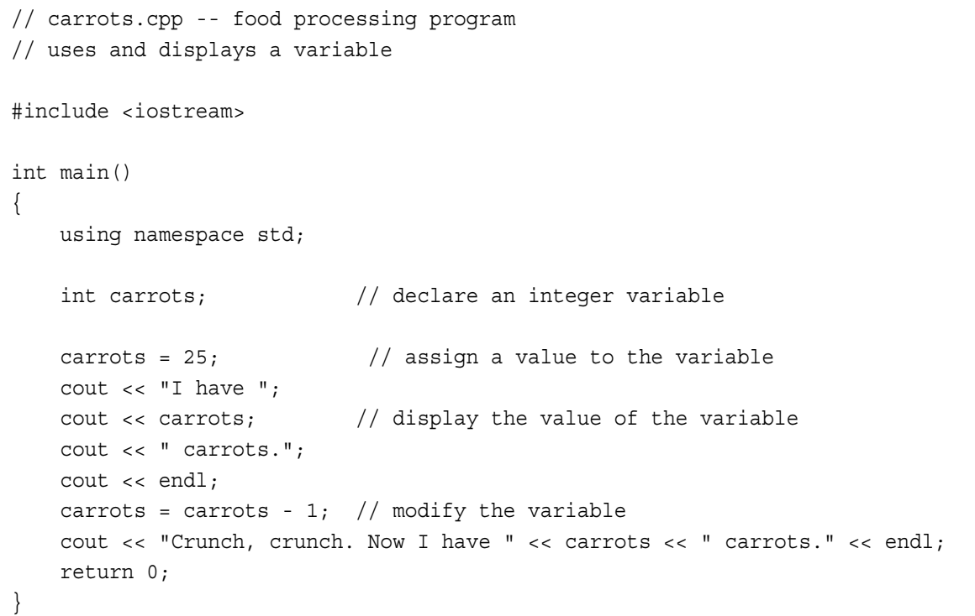
C++ Statements

Slide 13
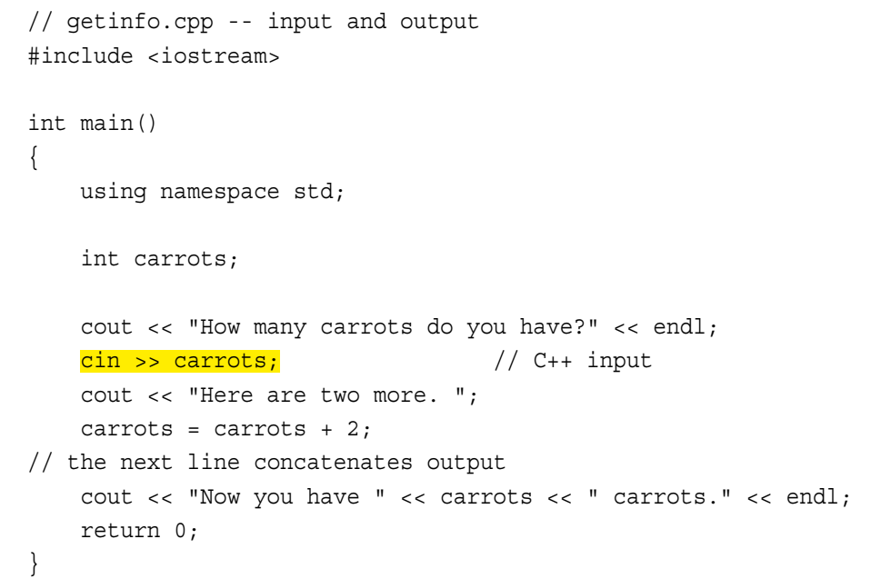
C++ Statements: cin

Slide 14
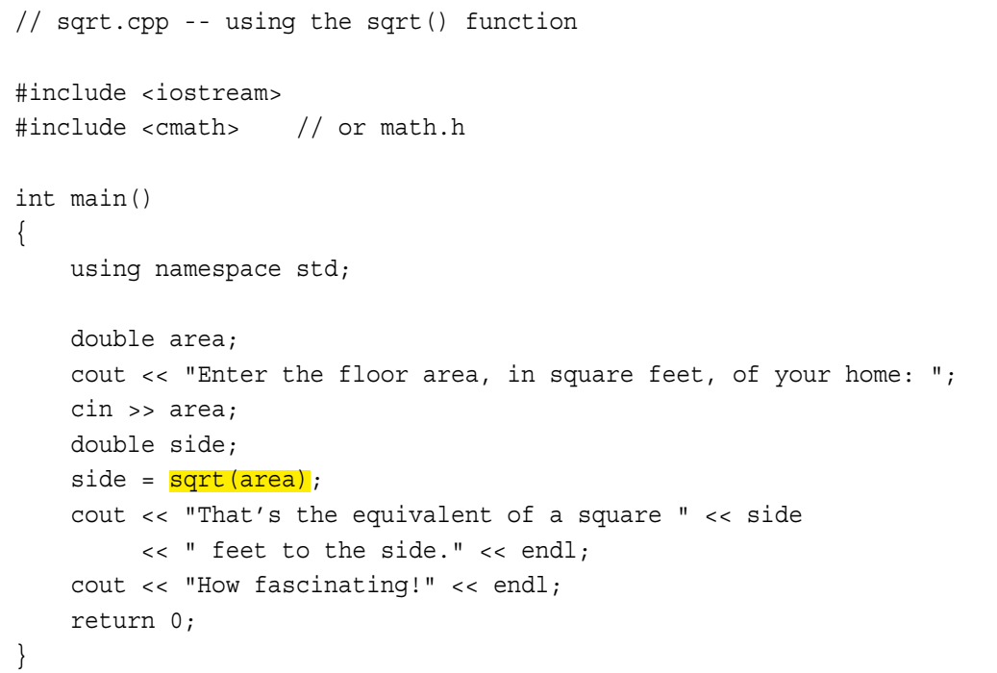
Functions

Slide 15
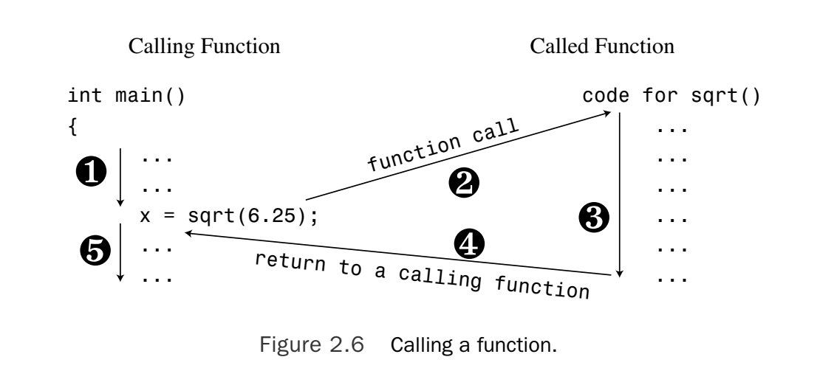
Functions
1
2
3
5
4

Slide 16
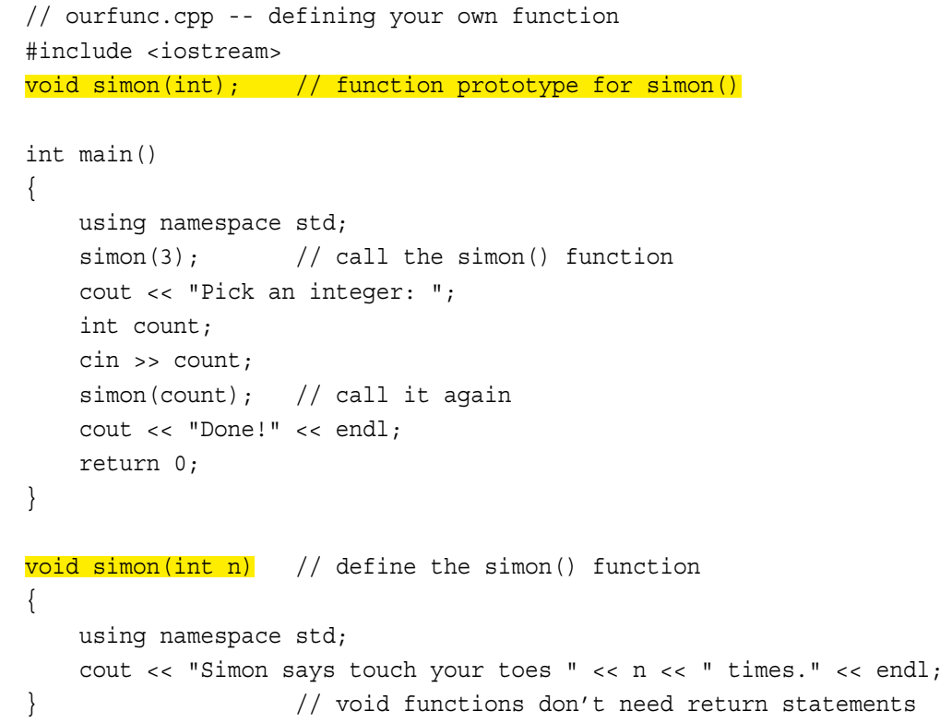
Functions: User-Defined Function

Slide 17
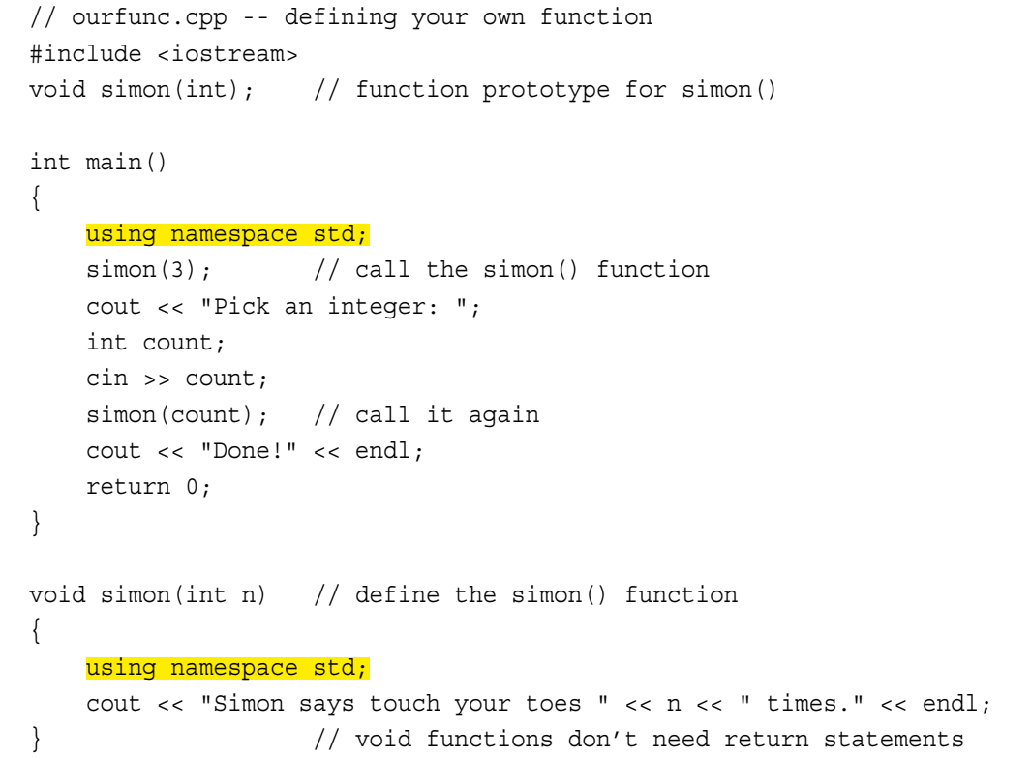
Functions: a bit on namespace

Slide 18
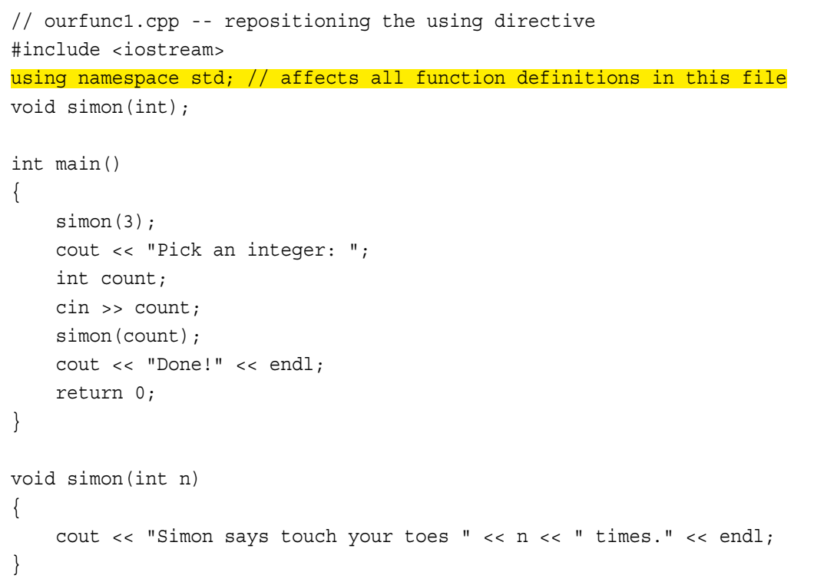
Functions: a bit on namespace

Slide 19
Programming Exercises
2.1 Write a C++ program that displays your name and address (or if you value your privacy, a fictitious name and address).
2.2 Write a C++ program that asks for a distance in furlongs and converts it to yards. (One furlong is 220 yards.)
Notes:
Makefile: https://blog.csdn.net/ZBraveHeart/article/details/123187908
Vim+c++环境：https://zhuanlan.zhihu.com/p/261665352
https://blog.csdn.net/weixin_41294183/article/details/117424147

Slide 20
Programming Exercises
2.3 Write a C++ program that uses three user-defined functions (counting main() as one) and produces the following output:
Three blind mice
Three blind mice
See how they run
See how they run
One function, called two times, should produce the first two lines, and the remaining function, also called twice, should produce the remaining output.

Slide 21
Programming Exercises
2.4 Write a program that has main() call a user-defined function that takes a Celsius temperature value as an argument and then returns the equivalent Fahrenheit value. The program should request the Celsius value as input from the user and display the result, as shown in the following code:
Please enter a Celsius value: 20
20 degrees Celsius is 68 degrees Fahrenheit.
For reference, here is the formula for making the conversion:
Fahrenheit = 1.8 × degrees Celsius + 32.0

Slide 22
Programming Exercises
2.5 Write a program that asks the user to enter an hour value and a minute value. The main() function should then pass these two values to a type void function that displays the two values in the format shown in the following sample run:
Enter the number of hours: 9
Enter the number of minutes: 28
Time: 9:28

